Slide 1

PHARMACY MANAGEMENT SYSTEM
#MedEasy – Making your day Easy

Slide 2
Table of contents
01
02
03
04
05
06
Objective
Key Learning
Industry Best Practices
Contributions
Technologies Implemented
Features of Admin and Employee

Slide 3






Team Members
Biswajit Ghosal
Ritwik Shaw
Pratik Biswas
Lokesh Reddy
Gaurav Kumar
Sandeep Kamila
Under the supervision of Avijit Chattopadhyay

Slide 4
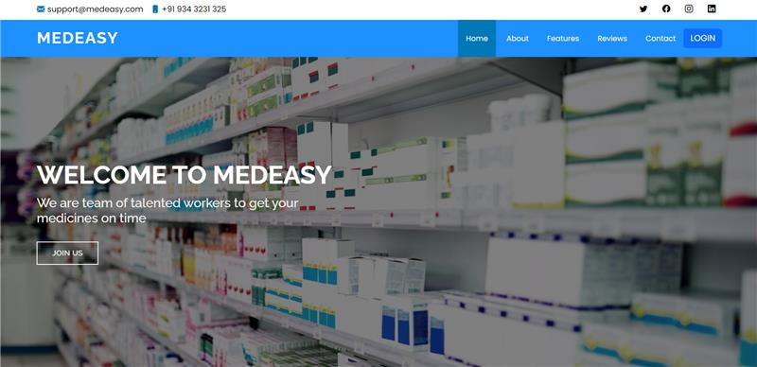
Objective
There are numerous pharmaceutical stores in India which are still using pen and paper method for billing, managing their employees and inventory system till date, we intend to digitize the processes.
The objective of the project is to provide solutions that will make service and billing process of a pharmaceutical store better by using modern technologies.
By implementing several functionalities the project team intends to exercise learning from Digital Internship Program.
At the end of the project the team learned several aspects of project delivery like using central repository, version control, agile methodology for delivery, and how to work in a collaborative environment.

Slide 5


Industry Best Practices
Use of MVC and service-oriented architecture.​
Effective Memory Management(Singleton Classes).​
Proper naming conventions for java classes, variables, functions.​
Code Reusability.​
Code Modularization.​
Proper Error Tracking & logging(Log4J).​
Java docs​.
GitHub as version control.​
Minimum use of Scriptlet tags in JSP.​
Implementation of JSON​ for data transfer.
Using PMD to find common programming flaws in our source code.
Notes:
Proper naming convention using camel case

Slide 6
Technologies Implemented
Technology | Description
Core JAVA / J2EE | Core Java is used for the backend purpose where we have used it in the model and service classes.
MySQL & JDBC | MySQL is used as the database management system for the project and JDBC is used to connect and execute the query with the database
JSP | It is used for creating dynamic web pages based on HTML
CSS, Bootstrap | CSS and bootstrap which is a CSS framework is used to design our JSP pages
JavaScript | It is used to implement the functionalities in our project
Chart JS | It is used to generate the sales report in our project
Struts 2 | It is the application framework for developing our Java EE web application based on the MVC architecture
jQuery & Ajax | Using this the web application can send and retrieve data from a server asynchronously without interfering with the display and behaviour of the existing page
JSTL | It is the standard tag library that provides tags to control the JSP page behaviour.
Rest APIs | It is used to fetch external data such as Aadhaar and pin code details required for the project
Java Mail | It is used to send email confirmations to the specific customer with order details
MD5 | It is used to encrypt user password before storing it into the database hence enhancing user security

Slide 7
Project Architecture
City and state details using pin code
BROWSER
(Chrome, Edge, Opera etc.)
Frontend
(JSP, CSS, Bootstrap, JavaScript)
MVC Architecture using Struts 2
(J2EE)
API
Req
Res
Aadhaar details
API
Google Maps
API
JDBC
MySQL
Apache Tomcat Web Server

Slide 8

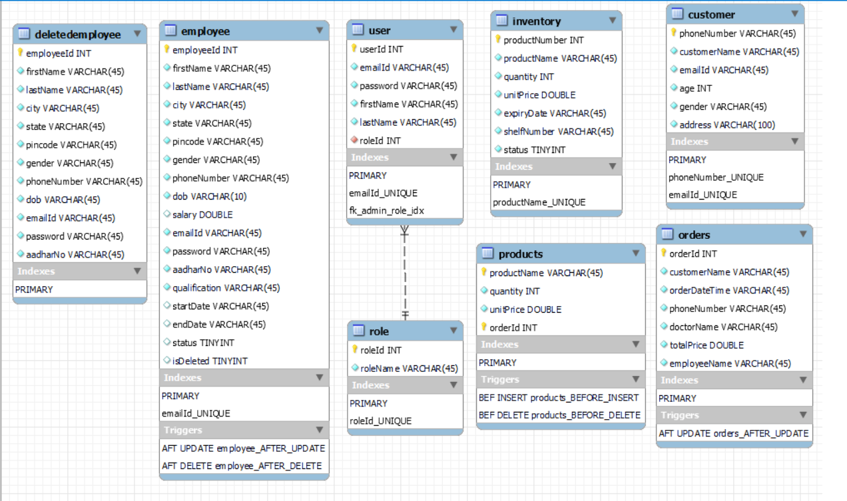
Database Design

Slide 9
Features of Admin
Admin can logout from the application after completing all the work
Logout
Login
Admin can login with email and password
Admin can view all the order history till date for auditing purpose
Admin can manage all his employees through these features
Order History
Show, Edit, Delete and Verify Employee
Admin can visualize all the sales of the store in the form of charts
Sales Report
Show Inventory
Admin can see all the available products in the store’s inventory
Admin can add new products in the inventory
Add product
Edit product
Admin can edit the details of the product and increase its quantity
Notes:
Thankyou Gaurav and Good morning everyone
So there are two flows in our application - the admin flow and the employee flow
Let us first discuss the features, the admin will get in the application
Firstly the admin, who can be the owner of the store, can login into the application with the email and password
The admin can verify the candidate who have applied as an employee and can manage the existing employees of the store. Admin can view and edit the details of employees and can remove the access to the employee
The admin can view the products available in the store's inventory and can edit the details of the product and can restock the product from the edit product feature and can add new pharmaceutical products in the store with the add product feature
There is also a sales report section where the admin can visualize all the sales of the store in a pictorial manner in the form of charts and can analyse the performane of the store
The admin can also view the order history till date for auditing purpose
And finally after finishing all the work the Admin can logout from the application thereby completing the admin flow

Slide 10
Features of Employee
Login
Add, Update Customer
Generate Invoice
Employee can login with email and password
Employee can manage the customer details
Employee will generate the invoice containing the details of the order
Show, Add, Edit Inventory
Order History
Logout
Employee can view, edit and add new products in the inventory
Employee can view all the order history till date and print that invoice
Employee can logout from the application after completing work
Notes:
Next lets discuss the features of employee
So just like the admin the employees of the store can login into the application with their registered email and password
The employee can manage the customer details he can add the details of new customer and can update the details of already existing customer and the employee will add all the medicines / products the customer wants and can generate an invoice containing the details of the order
Just like the admin the employees can also manage the inventory of the store by viewing, editing and adding new products in the store's inventory
The employee can view all the order history and can generate the invoice of that specific order
And finally after finishing their works the employees can logout from the application thereby completing the employee flow
We will view all these features in action during the application demo
And the next part will be presented by my fellow team member Lokesh . Over to you Lokesh

Slide 11
Development Issues Solutions
We were unable to imagine the finished product clearly at the beginning of the project.
Difficulty in collaborating with the group members.
Issues in developing features like employee functions and sales report.
We faced problems in database related operations.
After making the skeleton of the project it was easier to see the finished product
GitHub as a version control made it easier to integrate our separate progresses.
We did a significant amount of tinkering to get these features working correctly.
We learned and implemented the use of triggers to solve these problems

Slide 12
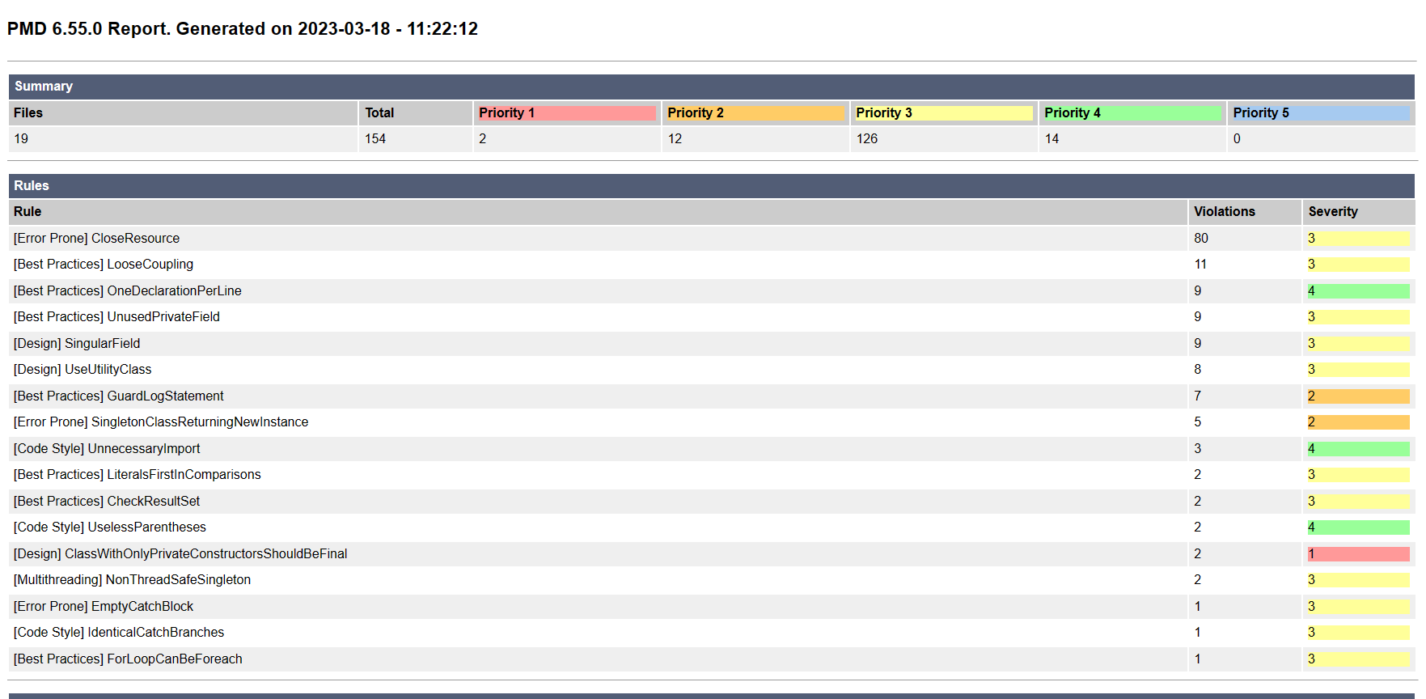
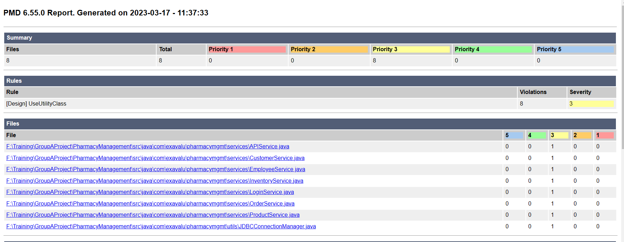
PMD Report Analysis
INITIAL
FINAL

Slide 13
Contributions
Biswajit Ghosal
Ritwik Shaw
Pratik Biswas
Project documentation
Database design
Model – Login, Product, Customer, MailSender
View – OrderHistory, Inventory, HomeEmployee
Service – OrderService, LoginService
Struts.XML
Project documentation
Database design
Model - Product
Service – ProductService
View – Signup, LoginPage, Invoice, homeEmployee, editProduct, editEmployee
Struts.XML
Project documentation
Database design
Model – Inventory, APIEmployee
View – LandingPage, VerifyEmployee, SalesReport
Service – InventoryService, APIService
Struts.XML
Lokesh Reddy
Gaurav Kumar
Sandeep Kamila
Project documentation
Database design
Model – Order
View – ShowEmployee, SalesReport, HomeAdmin
Service – CustomerService
Struts.XML
Project documentation
Database design
Model – Admin, Employee
View – SalesReport, EmployeeMenu, AddProduct
Service – EmployeeService, OrderService
Struts.XML
Project documentation
Database design
Model – Admin
View – OrderProduct, HomeEmployee, MenuAdmin, HomeAdmin
Struts.XML

Slide 14
Future Scope
A notification can be sent to the admin when the quantity of any product in the inventory drops below a specific quantity so that he can restock the product
We can add a feature for the customers to sign in and order pharmaceutical products online.
We can add a recommendation system where the customer can state their symptoms and the system will auto suggest them medicines.
We can use Artificial Intelligence and machine learning algorithms to optimise drug inventory and supply chain management.

Slide 15
Disclaimer
Landing Page
Day Bootstrap template: Day Bootstrap Template Demo (bootstrapmade.com)
Maps integration: Google Map API
Send email integration: Formspree
Signup Page
Template: 40+ Login/Sign up Form To Compliment Your Website 2021 (themewagon.com)
Sales Report
Template: Bootstrap template
Graph: Chart JS
Graph features: CDN JS
Invoice
Template: Bootstrap snippet. bs4 invoice (bootdey.com)

Slide 16
Thank You
Let us start with the project demo…

